Slide 1

Tensorflow tutorial
Yoon-gu Hwang

Slide 2

Tensorflow?
TensorFlow was originally developed by the Google Brain team for Google's research and production purposes
TensorFlow is Google Brain's second generation machine learning syste
Under the Apache 2.0 open source license on November 9, 2015

Slide 3
Simple mathematical expression
$$Minimize_{W, b} J\left(x\right)=E(f\left(W,b,x\right)−y)$$

Slide 4
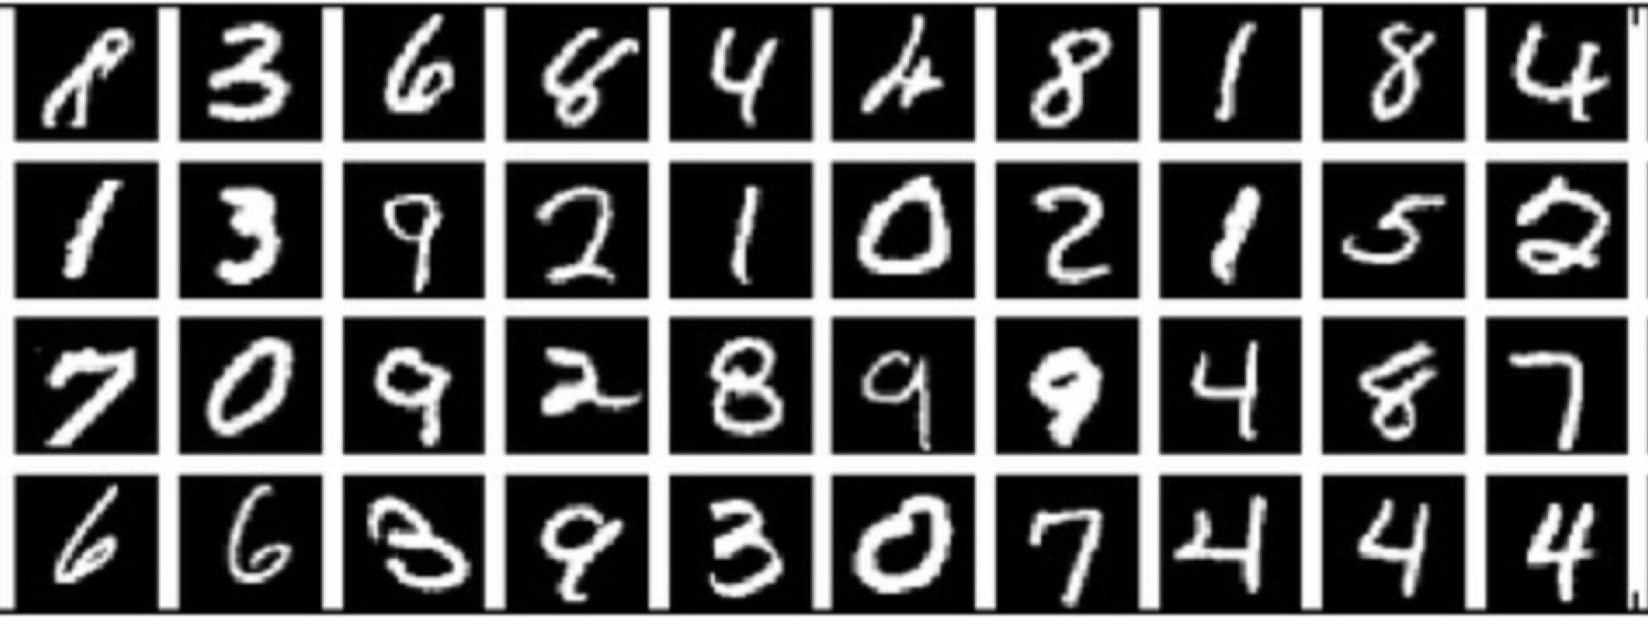
Mnist dataset

Slide 5
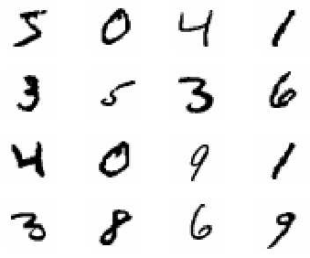
MNIST?
Mixed National Institute of Standards and Technology database
Handwritten Digits
55,000 training images
10,000 test images
28 x 28 images
28
28

Slide 6
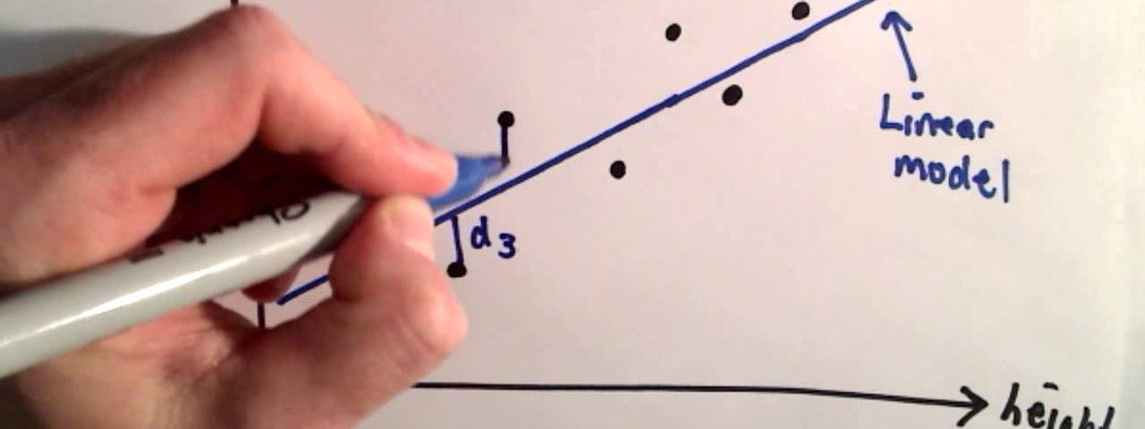
Linear regression

Slide 7
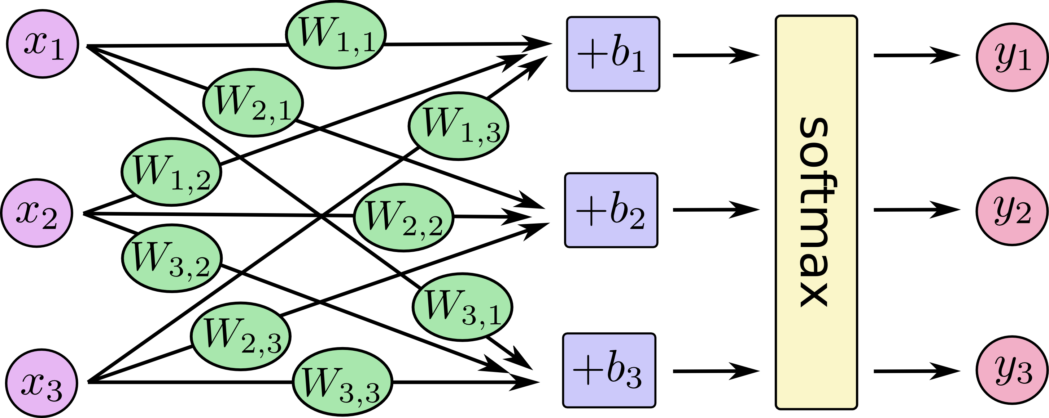

Slide 8
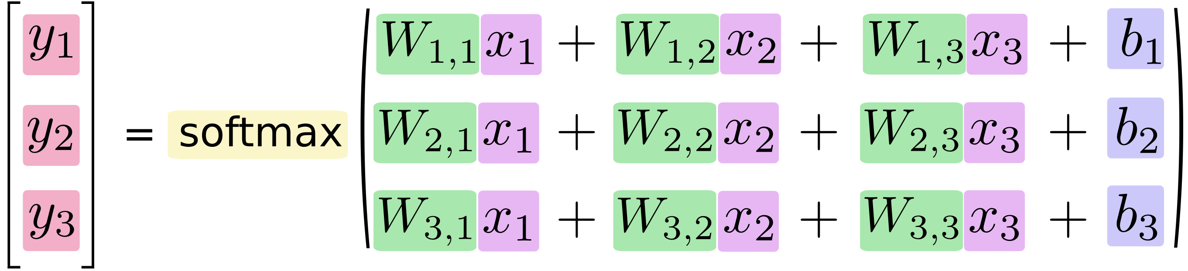

Slide 9
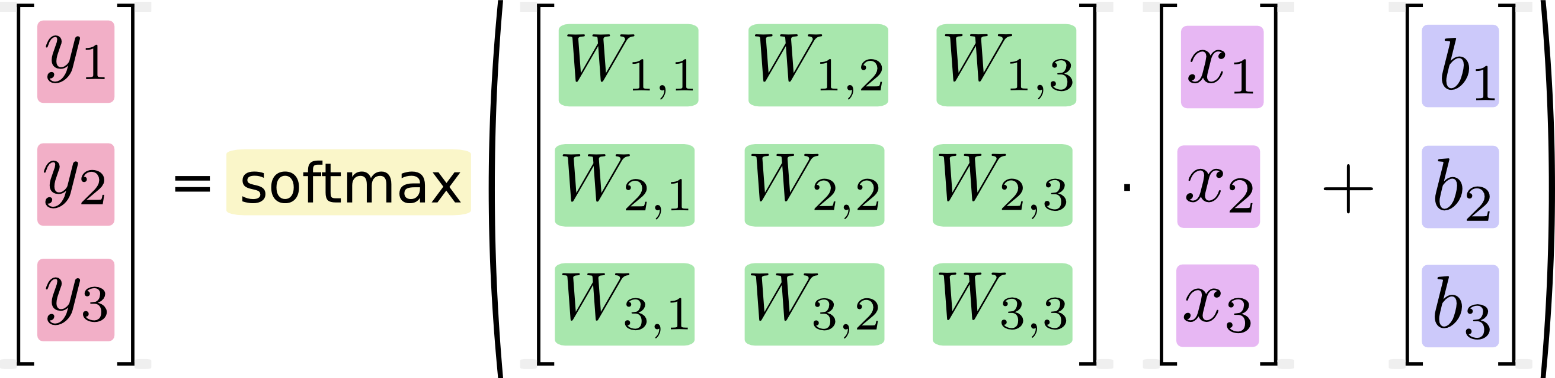

Slide 10
Variable types
x = tf.placeholder(…)
W = tf.Variable(…)
b = tf.Variable(…)
y = tf.nn.softmax(tf.matmul(x, W) + b)

Slide 11
Linear regression
Demo
https://github.com/yoon-gu/tensorflow-tutorial

Slide 12
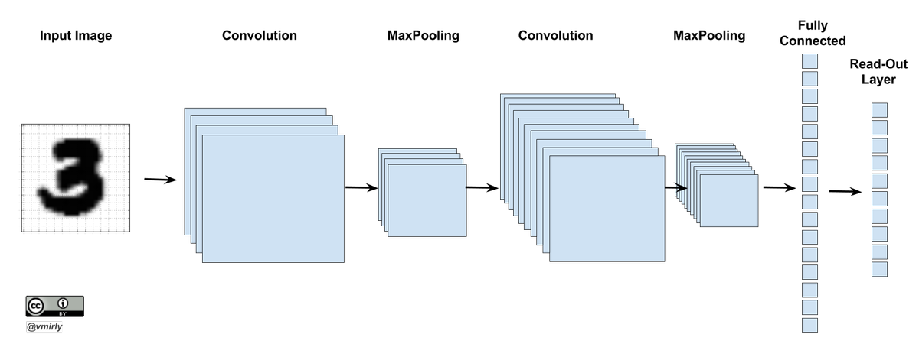
Convolutionary neural network

Slide 13
Before deep learning
Collect data
Feature Design
Feature Extraction
Machine Learning
We have to DESIGN filters to get features!

Slide 14
Feature extractions by Convolution
0 | 1 | 1 | 2 | 2 | 2 | 1 | 1 | 0
1 | 2 | 4 | 5 | 5 | 5 | 4 | 2 | 1
1 | 2 | 4 | 5 | 5 | 5 | 4 | 2 | 1
2 | 5 | 3 | 12 | 24 | 12 | 3 | 5 | 2
2 | 5 | 0 | 24 | 40 | 24 | 0 | 5 | 2
2 | 5 | 3 | 12 | 24 | 12 | 3 | 5 | 2
1 | 2 | 4 | 5 | 5 | 5 | 4 | 2 | 1
1 | 2 | 4 | 5 | 5 | 5 | 4 | 2 | 1
0 | 1 | 1 | 2 | 2 | 2 | 1 | 1 | 0
4 | 3 | 2 | 1 | 0 | -1 | -2 | -3 | -4
5 | 4 | 3 | 2 | 0 | -2 | -3 | -4 | -5
6 | 5 | 4 | 3 | 0 | -3 | -4 | -5 | -6
7 | 6 | 5 | 4 | 0 | -4 | -5 | -6 | -7
8 | 7 | 6 | 5 | 0 | -5 | -6 | -7 | -8
7 | 6 | 5 | 4 | 0 | -4 | -5 | -6 | -7
6 | 5 | 4 | 3 | 0 | -3 | -4 | -5 | -6
5 | 4 | 3 | 2 | 0 | -2 | -3 | -4 | -5
4 | 3 | 2 | 1 | 0 | -1 | -2 | -3 | -4
0 | 1 | 1 | 2 | 2 | 2 | 1 | 1 | 0
1 | 2 | 4 | 5 | 5 | 5 | 4 | 2 | 1
1 | 2 | 4 | 5 | 5 | 5 | 4 | 2 | 1
2 | 5 | 3 | -12 | -24 | -12 | 3 | 5 | 2
2 | 5 | 0 | -24 | -40 | -24 | 0 | 5 | 2
2 | 5 | 3 | -12 | -24 | -12 | 3 | 5 | 2
1 | 2 | 4 | 5 | 5 | 5 | 4 | 2 | 1
1 | 2 | 4 | 5 | 5 | 5 | 4 | 2 | 1
0 | 1 | 1 | 2 | 2 | 2 | 1 | 1 | 0
9
9
9
9

Slide 15
Example 1
Moving Average
Sobel
Laplacian

Slide 16
Example 2
Moving Average
Sobel
Laplacian

Slide 17
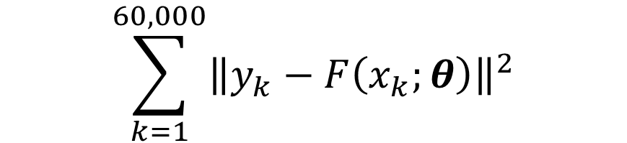
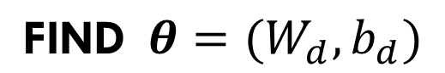
Optimization Problem 1
$$\text{FIND} θ=(W_{d},b_{d})$$
$$\sum_{k=1}^{60,000}{{\left\|y_{k}−F\left(x_{k};θ\right)\right\|}^{2}}$$
that MINIMIZE

Slide 18
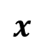

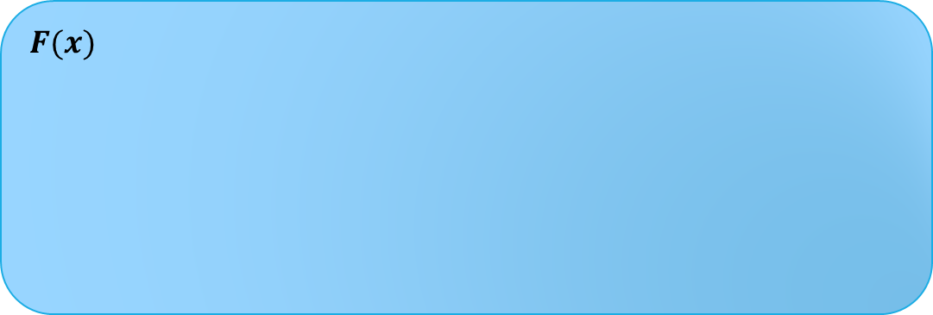
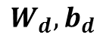

Flow
For given $W_{d}$ and $b_{d},$
$$F(x)$$
28x28
Feature Extraction
(Convolution)
Sigmoid
Pooling
Softmax
Image
$$x$$
Prob
$$y$$
$$W_{d}, b_{d}$$
[20x20] x 9
[20x20] x 9
[10x10] x 9
10 x 1

Slide 19
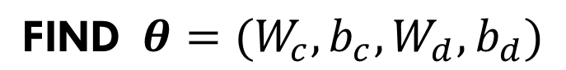
Optimization Problem 2
$$\text{FIND} θ={(W}_{c}, b_{c}, W_{d},b_{d})$$
$$\sum_{k=1}^{60,000}{{\left\|y_{k}−F\left(x_{k};θ\right)\right\|}^{2}}$$
that MINIMIZE

Slide 20

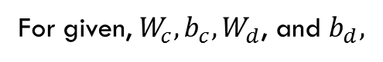
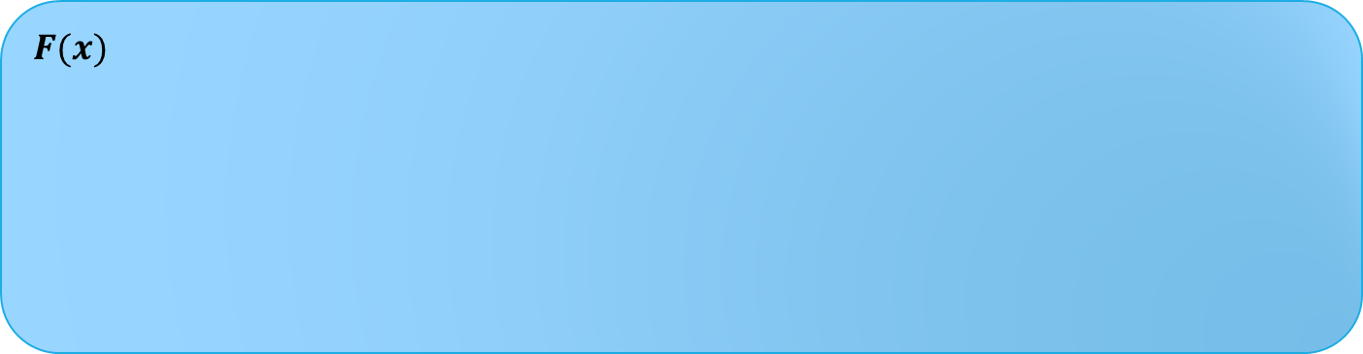
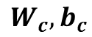
Flow
For given, $W_{c}, b_{c}, W_{d}$, and $b_{d},$
$$F(x)$$
28x28
Convolution
Sigmoid
Pooling
Softmax
Image
$$x$$
Prob
$$y$$
$$W_{c}, b_{c}$$
$$W_{d}, b_{d}$$
[20x20] x 9
[20x20] x 9
[10x10] x 9
10 x 1

Slide 21
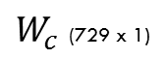
Parameter visualization
$W_{c}$ (729 x 1)
1st
9x9=81
9x9=81
2nd
9x9=81
8th
…
3rd
9th
9x9=81
9x9=81

Slide 22
CNN Demo
https://github.com/yoon-gu/tensorflow-tutorial

Slide 23

GPU Acceleration

Slide 24
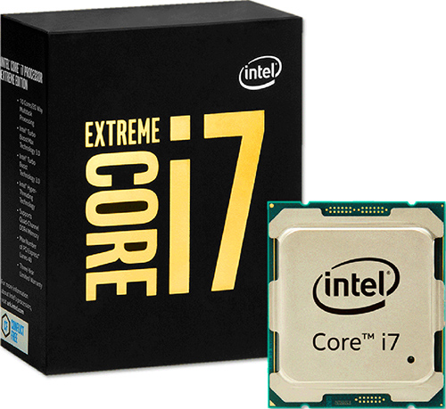
Performance
23 minutes VS 2 minutes
Intel® Core™ i7-6900K @ 3.20GHz
NVIDIA Geforce GTX 1080

Slide 25

Question?

